Slide 1
College Management System
-Avi Khadka
-Sakshyam Khadka

Slide 2
Introduction
Need for efficient digital college management.
Problems with manual systems.
Centralized web-based solution.

Slide 3
Problem Statement
Manual workload
Data inconsistency
Poor communication
Lack of reporting

Slide 4
Objectives
Automate processes
Reduce errors
Secure access
Improve communication

Slide 5
Scope
Student Module
Admin Module
Exam Module
Web-based access

Slide 6
Limitations
Internet dependency
Hardware dependency
No mobile app

Slide 7
Background Study
Traditional paper-based systems
Need for centralized digital solution

Slide 8
Literature Review
Existing digital systems
Benefits of centralization
Use of MERN stack

Slide 9
System Analysis
Waterfall Model
Requirement analysis
Design and development

Slide 10
Functional Requirements
Student, Admin, Exam Modules
CRUD operations
Authentication

Slide 11
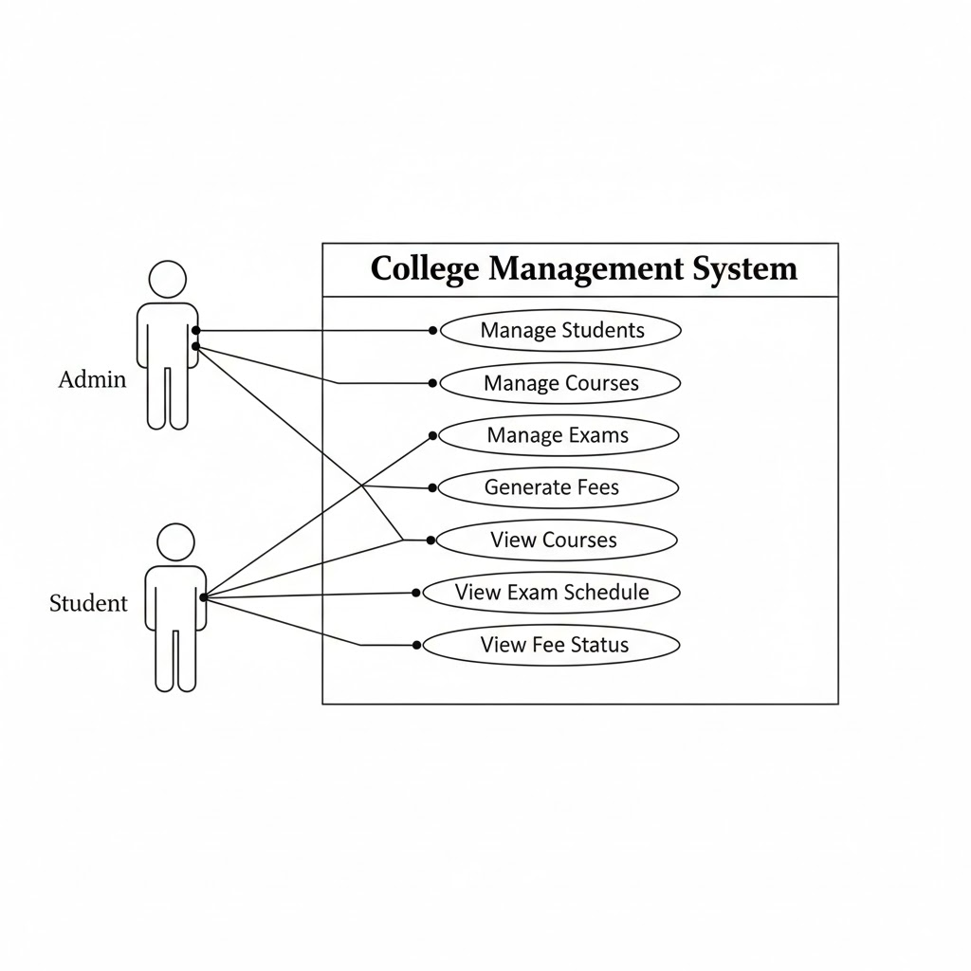
USE CASE

Slide 12
Non-Functional Requirements
Security
Accuracy
Efficiency
Usability

Slide 13
Feasibility Analysis
Technical feasibility
Economic feasibility
Operational feasibility

Slide 14
Implementation
Frontend: React
Backend: Node & Express
Database: MySQL

Slide 15
Tools & Technology
VS Code
Postman
Git
XAMPP

Slide 16
Future Enhancements
Mobile app
Cloud hosting
Online payment
Analytics

Slide 17
Conclusion
System improves efficiency and accuracy
Reduces manual workload

